Slide 1
CHI-SQUARE DISTRIBUTION
Panchami v t

Slide 2
INTRODUCTION
The chi – square test is one of the most commonly used non-parametric test, in which the sampling distribution of the test statistics is a chi-square distribution, when the null hypothesis is true.
It was introduced by Karl Pearson as a test of association. The Greek Letter X² is used to denote this test.
It can be applied when there are few or no assumptions about the population parameter.
It can be applied on categorical data or qualitative data using a contingency table.
It is used to evaluate unpaired/unrelated samples and proportions.

Slide 3
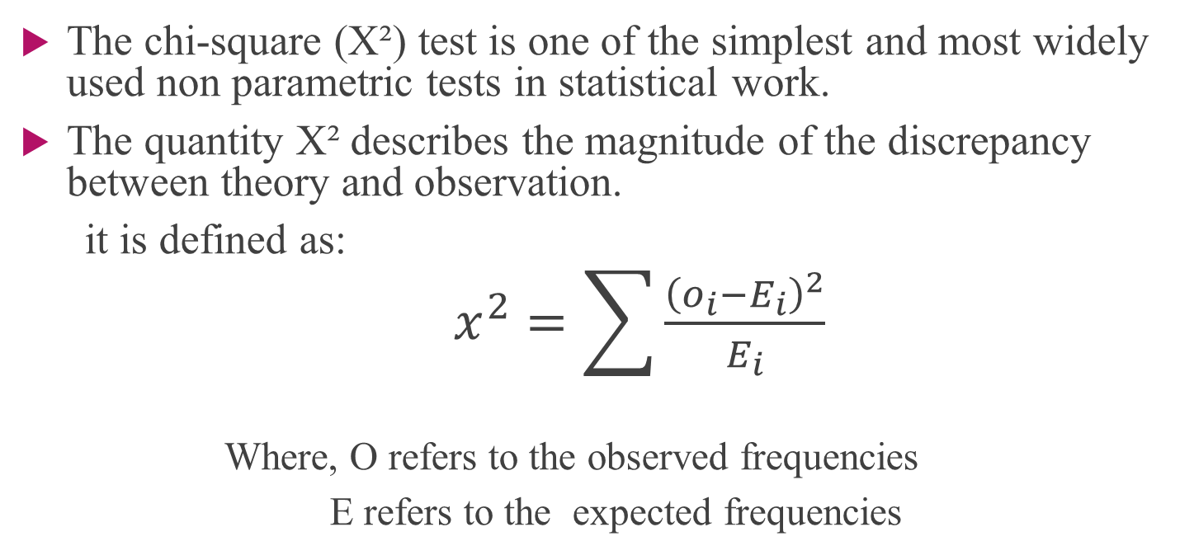
DEFINITION
The chi-square (X²) test is one of the simplest and most widely used non parametric tests in statistical work.
The quantity X² describes the magnitude of the discrepancy between theory and observation.
it is defined as:
$x^{2}=\sum{\frac{{\left(o_{i}−E_{i}\right)}^{2}}{E_{i}}}$
Where, O refers to the observed frequencies
E refers to the expected frequencies

Slide 4
NOTE
If X² is Zero, it means that observed and expected frequencies coincide with each other.
The greater the discrepancy between the observed and expected frequencies the greater is the value of X².

Slide 5
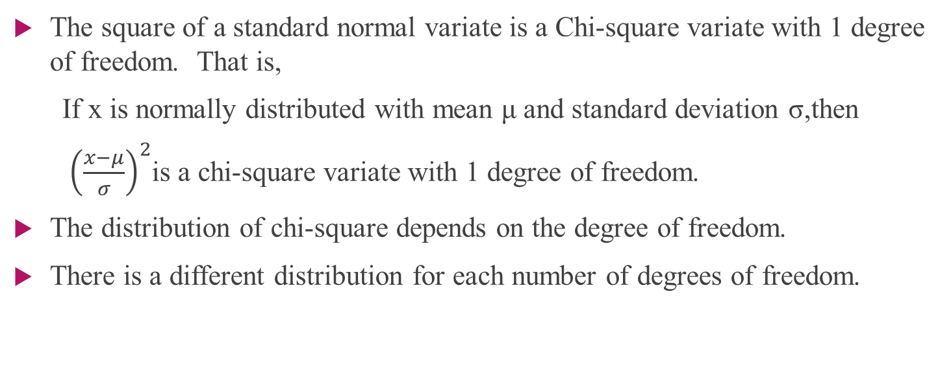
CHI-SQUARE DISTRIBUTION
The square of a standard normal variate is a Chi-square variate with 1 degree of freedom. That is,
If x is normally distributed with mean μ and standard deviation σ,then
${\left(\frac{x−μ}{σ}\right)}^{2}$is a chi-square variate with 1 degree of freedom.
The distribution of chi-square depends on the degree of freedom.
There is a different distribution for each number of degrees of freedom.

Slide 6
PROPERTIES OF CHI-SQUARE DISTRIBUTION
The mean of X² distribution is equal to the number of degrees of freedom(n).
The variance is equal to two times the number of degrees of freedom,2n
The median of a X² distribution divides, the area of the curve into two equal parts, each being 0.5.
The mode of X² distribution is equal to (n-2).
Since X² values always positive, the X² curve is always positively skewed.
The lowest value of X² is zero and the highest value is infinity.
X² increases with increase in ‘n’, there is a new X² distribution with every increase in the ‘n’.

Slide 7
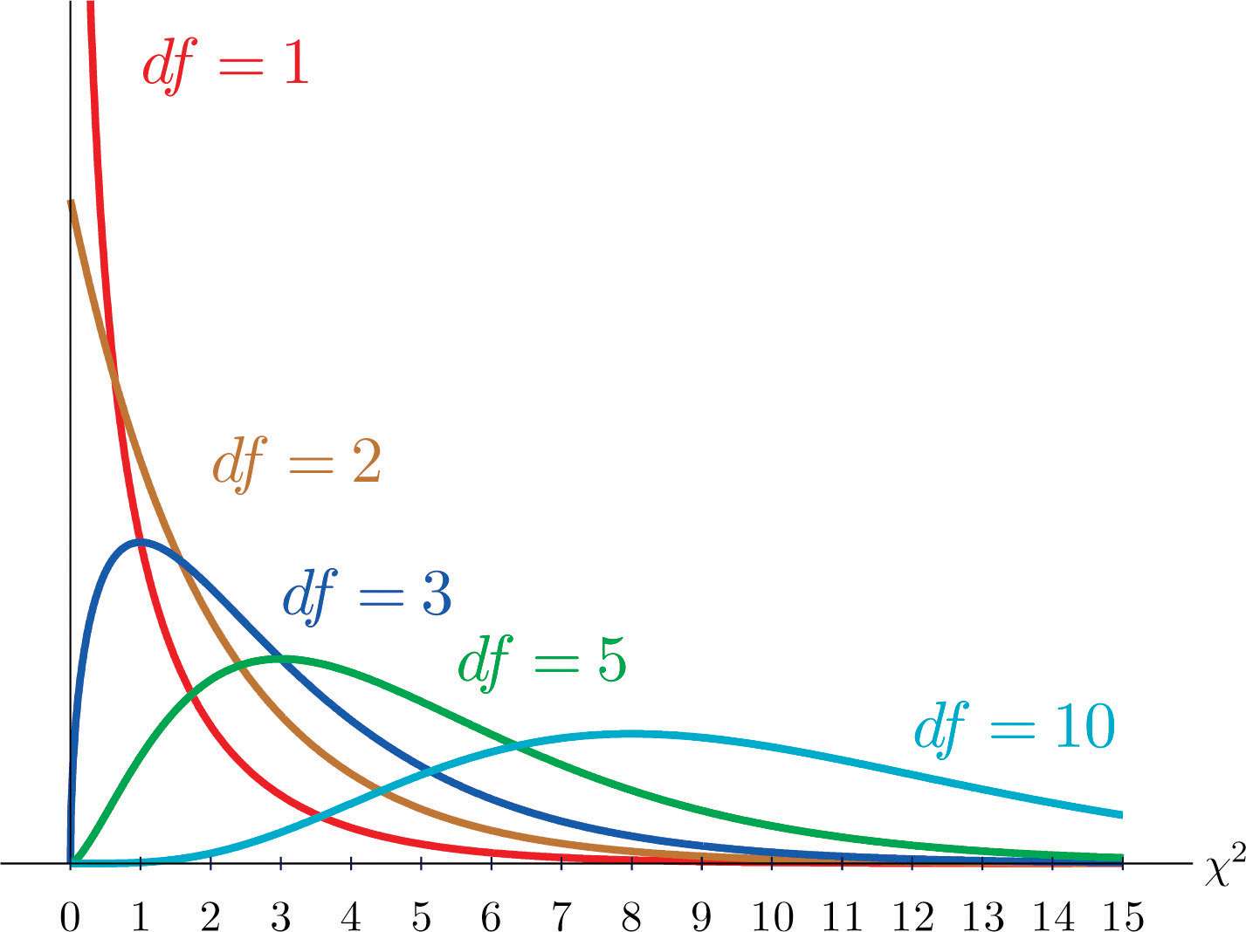
The X² distribution is not symmetrical and all the values are positive. The distribution is described by degrees of freedom we have asymmetric curves.

Slide 8
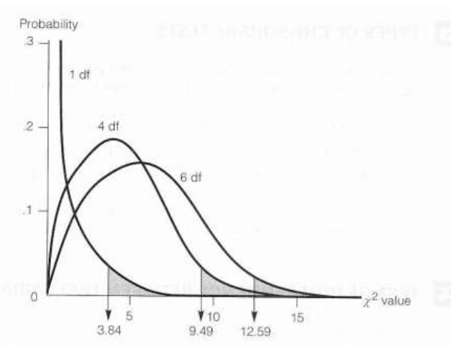
As the degree of freedom increase, the chi-square curve approaches a normal distribution.
The chi-square distribution for varying degrees of freedom.

Slide 9
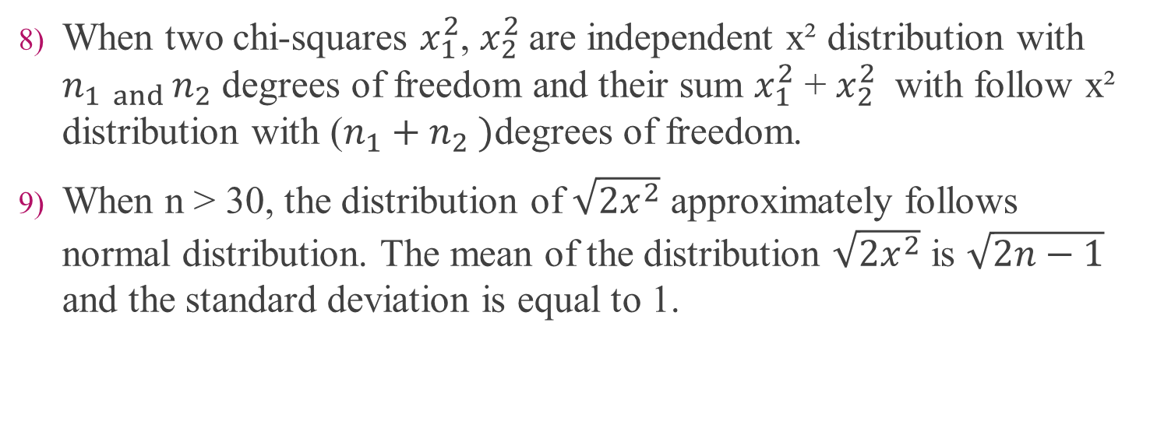
PROPERTIES OF CHI-SQUARE DISTRIBUTION
When two chi-squares $x_{1}^{2}$, $x_{2}^{2}$are independent x² distribution with $n_{1 and }n_{2}$ degrees of freedom and their sum $x_{1}^{2}$ + $x_{2}^{2}$ with follow x² distribution with ($n_{1}+n_{2} )$degrees of freedom.
When n > 30, the distribution of $\sqrt{2x^{2}}$ approximately follows normal distribution. The mean of the distribution $\sqrt{2x^{2}}$ is $\sqrt{2n−1}$ and the standard deviation is equal to 1.

Slide 10
APPLICATION OF CHI-SQUARE DISTRIBUTION
This test can be used in,
Goodness of fit of distributions
Test of independence of attributes
Test of homogeneity

Slide 11
SHAPE OF DISTRIBUTION
If degree of freedom > 2 : Distribution is bell shaped
If degree of freedom = 2 : Distribution is L shaped with maximum ordinate at zero
If degree of freedom < 2 (>0) : Distribution is L shaped with infinite ordinate at the origin.

Slide 12
CONDITIONS FOR APPLYING X² TEST
The data must be in the form of frequencies
All the items in the sample must independent
N, the total frequency should be reasonably large, say greater than 50.
No theoretical cell - frequency should be less than 5.If it is less than 5, the frequencies should be pooled together in order to make it 5 or more than 5.
X² test is wholly dependent on degrees of freedom.

Slide 13
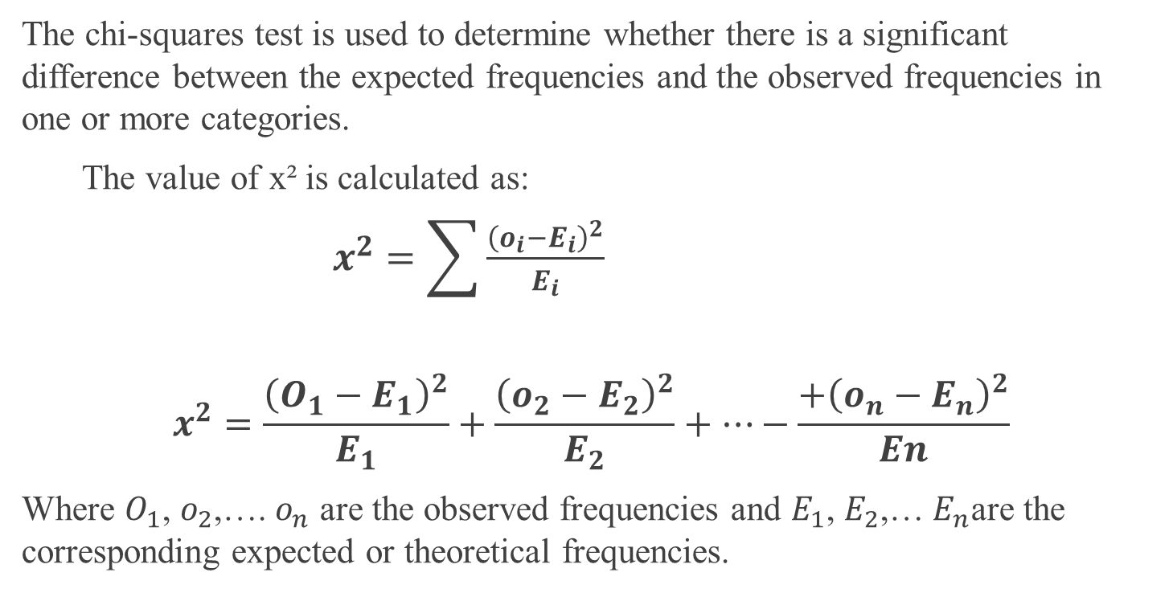
CHI-SQUARE FORMULA
The chi-squares test is used to determine whether there is a significant difference between the expected frequencies and the observed frequencies in one or more categories.
The value of x² is calculated as:
$x^{2}=\sum{\frac{{\left(o_{i}−E_{i}\right)}^{2}}{E_{i}}}$
$$x^{2}=\frac{{\left(O_{1}−E_{1}\right)}^{2}}{E_{1}}+\frac{{\left(o_{2}−E_{2}\right)}^{2}}{E_{2}}+⋯−\frac{+{\left(o_{n}−E_{n}\right)}^{2}}{En}$$
Where $O_{1}$, $o_{2}$,…. $o_{n}$ are the observed frequencies and $E_{1}$, $E_{2}$,… $E_{n}$are the corresponding expected or theoretical frequencies.

Slide 14
DEGREES OF FREEDOM
It denotes the extent of independence (freedom) enjoyed by a given set of observed frequencies. Suppose we are given a set of n observed frequencies which are subjected to k independent constraints (restrictions) then,
d.f = (Number of frequencies) – (Number of independent constraints on them)
In other terms,
d.f = (r – 1) (c-1)
Where,
r = The number of rows
c = The number of columns

Slide 15
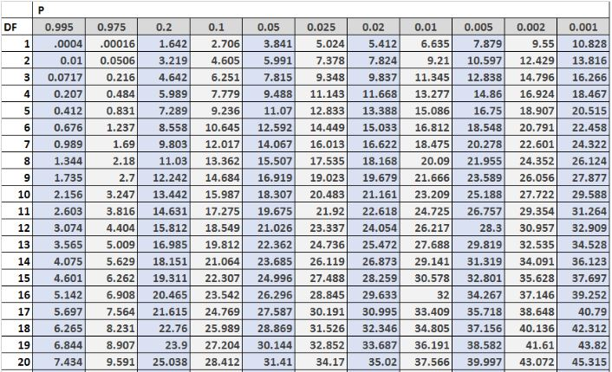
CRITICAL VALUES OF CHI-SQUARE

Slide 16
CONDITIONS FOR APPLYING CHI-SQUARE TEST
The data used in Chi-Square test must be quantitative and in the form of frequencies, which must be absolute and not in relative terms.
The total number of observations collected for this test must be large ( at least 10) and should be done on a random basis.
Each of the observations which make up the sample of this test must be independent of each other.
The expected frequency of any item or cell must not be less than 5; the frequencies of adjacent items or cells should be polled together in order to make it more than 5.
This test is used only for drawing inferences through test of the hypothesis, so it cannot be used for estimation of parameter value.

Slide 17
PRACTICAL APPLICATION OF CHI-SQUARE TEST
The applications of Chi-Square test include testing:
The significance of sample & population variances [σ 2 s & σ 2 p] 2.
The goodness of fit of a theoretical distribution:
Testing for goodness of fit determines if an observed frequency distribution fits/matches a theoretical frequency distribution (Binomial distribution, Poisson distribution or Normal distribution). These test results are helpful to know whether the samples are drawn from identical distributions or not. When the calculated value of χ 2 is less than the table value at certain level of significance, the fit is considered to be good one and if the calculated value is greater than the table value, the fit is not considered to be good.

Slide 18
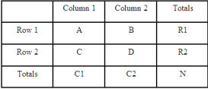
CONTIGENCY TABLE
A contingency table is a type of table in a matrix format that displays the frequency distribution of the variables.
They provide a basic picture of the interrelation between two variables and can help find interactions between them.
The chi-square statistic compares the observed count in each table cell to the count which would be expected under the assumption of no association between the row and column classifications

Slide 19
APPLICATIONS
The independence in a contingency table:
Testing independence determines whether two or more observations across two populations are dependent on each other.
If the calculated value is less than the table value at certain level of significance for a given degree of freedom, then it is concluded that null hypothesis is true, which means that two attributes are independent and hence not associated.
If calculated value is greater than the table value, then the null hypothesis is rejected, which means that two attributes are dependent.
The chi-square test can be used to test the strength of the association between exposure and disease in a cohort study, an unmatched casecontrol study, or a cross-sectional study.

Slide 20
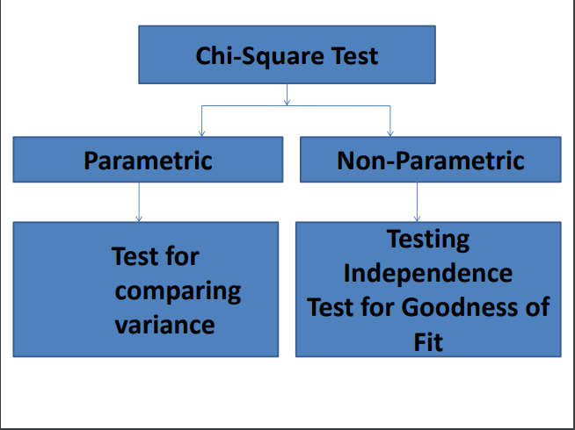

Slide 21
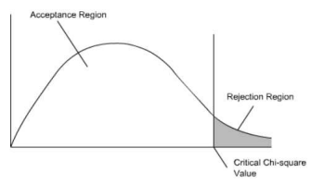
INTERPRETATION OF CHI-SQUARE VALUES
The χ 2 statistic is calculated under the assumption of no association.
Large value of χ 2 statistic ⇒ Small probability of occurring by chance alone (p < 0.05) ⇒ Conclude that association exists between disease and exposure(Null hypothesis rejected).
Small value of χ 2 statistic ⇒ Large probability of occurring by chance alone (p > 0.05) ⇒ Conclude that no association exists between disease and exposure(Null hypothesis accepted).
The left hand side indicates the degrees of freedom.If the calculated value of χ2 falls in the acceptance region, the null hypothesis ‘Ho’ is accepted and vice-versa.

Slide 22
EXAMPLE
256 visual artists were surveyed to find out their zodiac sign. The results were: Aries (29), Taurus (24), Gemini (22), Cancer (19), Leo (21), Virgo (18), Libra (19), Scorpio (20), Sagittarius (23), Capricorn (18), Aquarius (20), Pisces (23). Test the hypothesis that zodiac signs are evenly distributed across visual artists.
SOLUTION
Make a table with columns for “Categories,” “Observed,” “Expected,” “Residual (Obs-Exp)”, “(Obs-Exp)²” and “Component (Obs-Exp)² / Exp.” Don’t worry what these mean right now; We’ll cover that in the following steps. Fill the categories. Categories should be given in the question.

Slide 23
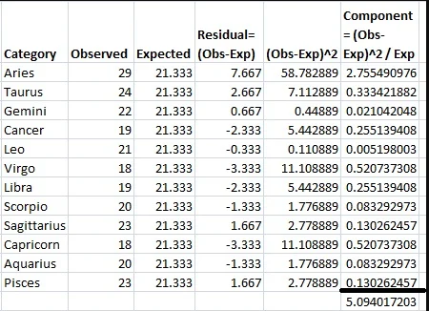
We get the table as:

Slide 24
We get chi-square statistic as 5.094
Find the p-value in the chi-square table. The closest value for df=11 and 5.094 is between .995 and .975. By using this information we Decide whether to support or reject the null hypothesis.
In general, small p-values (1% to 5%) would cause you to reject the null hypothesis.
This very large p-value means that the null hypothesis should not be rejected.

Slide 25
LIMITATIONS OF CHI-SQUARE
The chi-square test does not give us much information about the strength of the relationship. It only conveys the existence or nonexistence of the relationships between the variables investigated.
The chi-square test is sensitive to sample size. This may make a weak relationship statistically significant if the sample is large enough. Therefore, chi-square should be used together with measures of association like lambda, Cramer's V or gamma to guide in deciding whether a relationship is important and worth pursuing.
The chi-square test is also sensitive to small expected frequencies. It can be used only when not more than 20% of the cells have an expected frequency of less than 5.
Cannot be used when samples are related or matched.

Slide 26
THANK YOU

